Slide 1


Basics of Atomic Theories
M.Arif
25F-CY-094
Notes:
Are your classroom colors different than what you see in this template? That’s OK! Click on Design -> Variants (the down arrow) -> Pick the color scheme that works for you!
Feel free to change any “You will…” and “I will…” statements to ensure they align with your classroom procedures and rules!

Slide 2
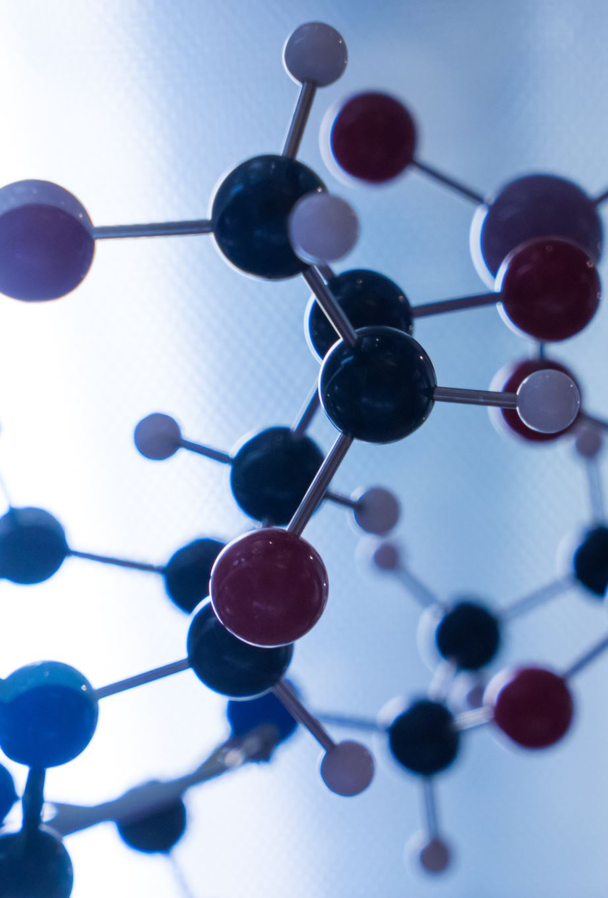
Basics of Atomic Theories
Atomic theory deals with the study of atoms as the fundamental units of matter. It helps us understand how matter is structured and why substances behave the way they do.
Early ideas about atoms were philosophical, but scientific atomic theory developed through experimentation. Discoveries in electricity and radiation played a major role in shaping atomic models.
Today, atomic theory is explained using quantum concepts, which describe electrons in terms of energy states and probabilities rather than fixed paths.

Slide 3
Dalton’s Atomic Theory
John Dalton introduced the first modern atomic theory based on experimental evidence. He suggested that all matter is made of extremely small particles known as atoms.
Dalton stated that atoms of a particular element are identical, while atoms of different elements have different masses and properties. Chemical reactions occur when atoms combine or separate.
Although Dalton’s theory had limitations, it laid the groundwork for future discoveries in atomic structure and chemistry.

Slide 4
Thomson, Rutherford, and Bohr Models
J.J. Thomson discovered electrons and proposed that atoms consist of a positive mass with negatively charged electrons embedded inside it.
Later, Rutherford’s experiment showed that positive charge and most of the mass are concentrated in a tiny nucleus at the center of the atom. This revealed that atoms are mostly empty space.
Bohr refined this model by suggesting that electrons revolve in specific energy levels, helping explain atomic stability and emission spectra.

Slide 5
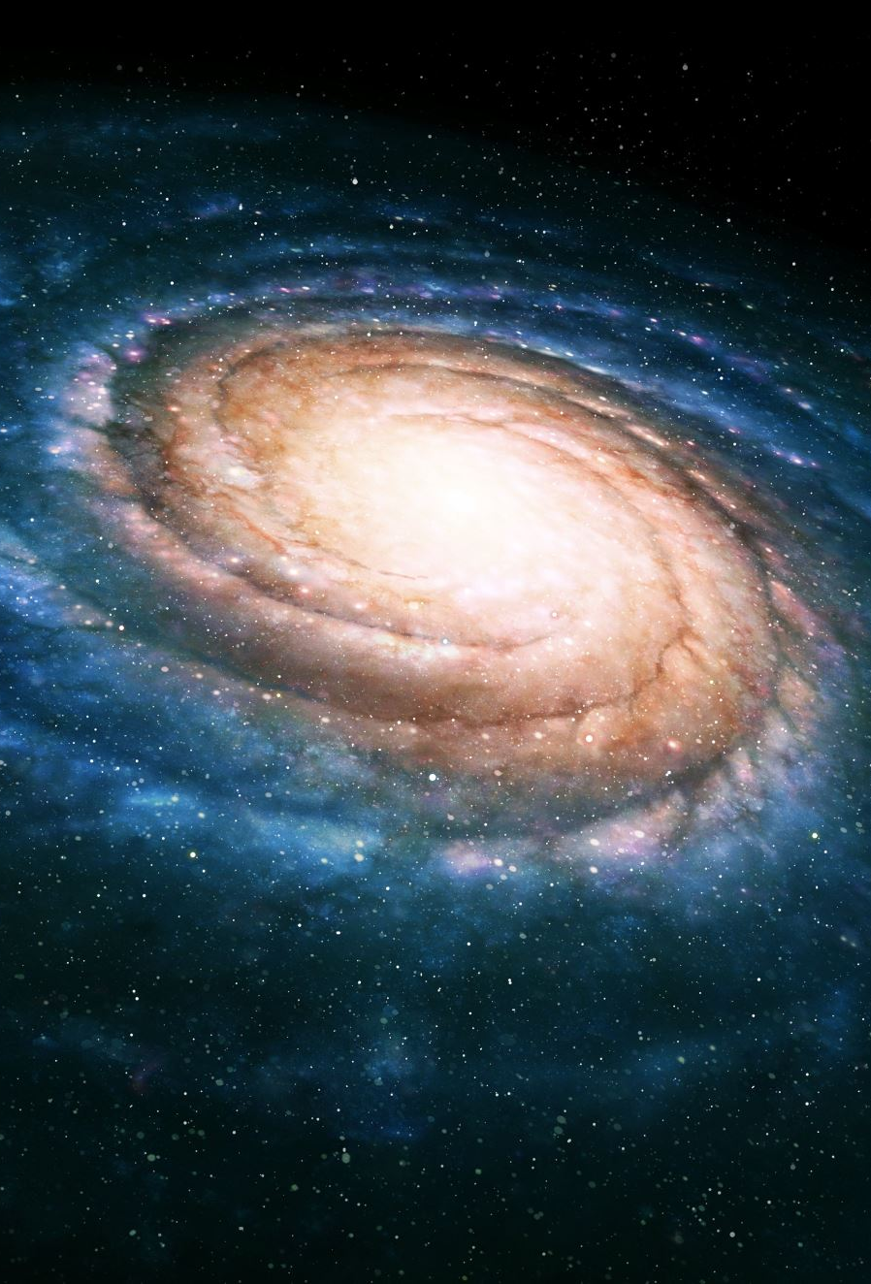
Introduction to Particle Physics
Particle physics focuses on understanding the smallest known particles in nature. It studies how these particles interact through fundamental forces.
High-energy experiments allow scientists to observe rare particle interactions. Particle accelerators play a key role in discovering new particles.
This field contributes to our understanding of the universe, including its origin and evolution.

Slide 6
Fundamental Particles
Fundamental particles are divided into matter particles and force carriers. Matter particles are known as fermions.
Fermions include quarks, which form protons and neutrons, and leptons such as electrons. These particles make up all visible matter.
Force carriers, called bosons, transmit forces between particles. Examples include photons and gluons.

Slide 7
Standard Model of Particle Physics
The Standard Model is a theoretical framework that describes known fundamental particles and their interactions. It unifies electromagnetic, weak, and strong forces.
The model includes quarks, leptons, gauge bosons, and the Higgs boson. The Higgs field explains how particles acquire mass.
However, gravity is not included in the Standard Model, making it incomplete and an active area of research.

